Slide 1
Steps to download a firmware to GP device

Slide 2
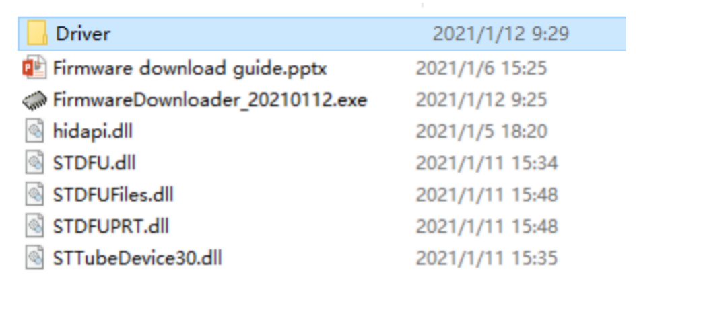
Install ST DFU driver
Switch to download mode, the device will become a DFU device, which needs ST DFU driver supported. Install a proper one according to your windows version.

Slide 3
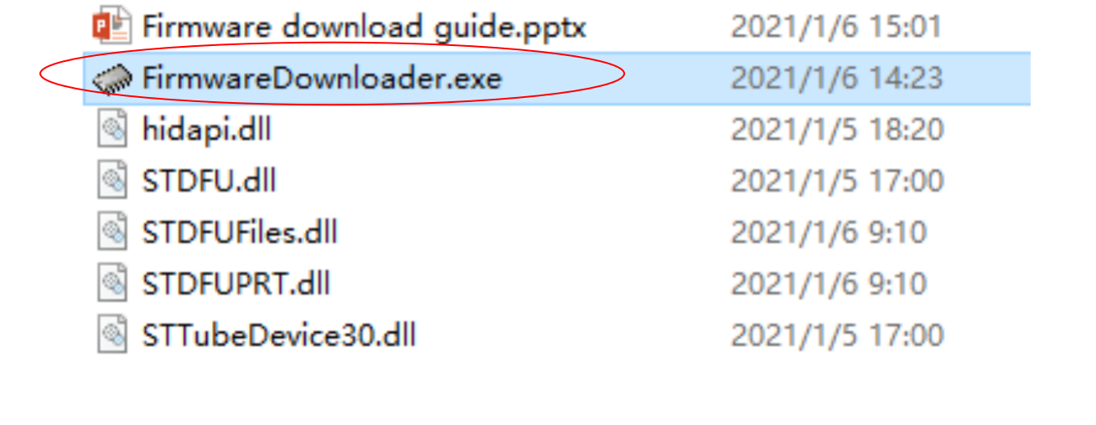
Run FirmwareDownloader.exe

Slide 4
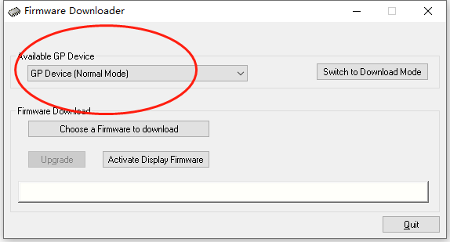
A GP device will be detected if plugged, which is in normal mode

Slide 5
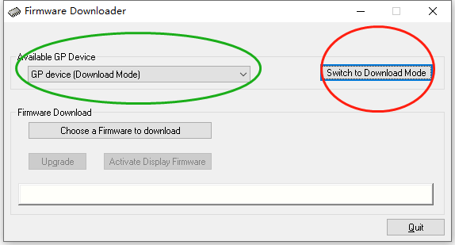
Click button to switch to download mode, then a device in download mode will be detected.

Slide 6
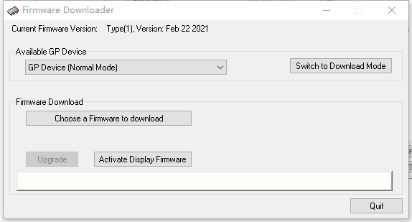
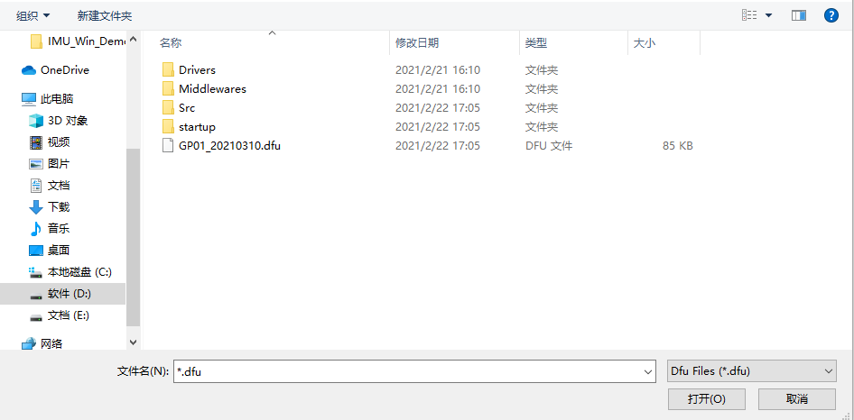
Click button to select a firmware to be downloaded.

Slide 7
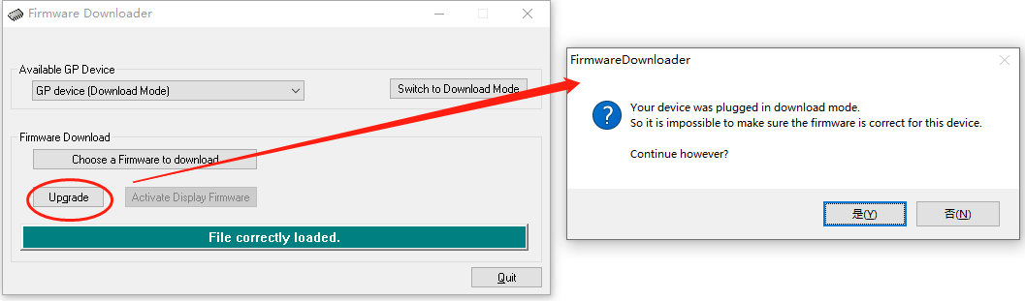
The upgrade button will be enabled. After clicking it, a confirming message will be prompted.

Slide 8
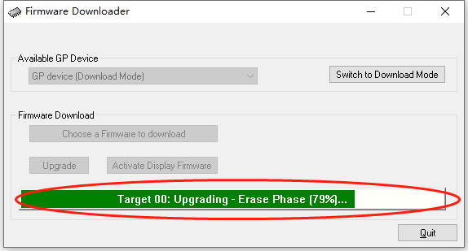
Start upgrading

Slide 9
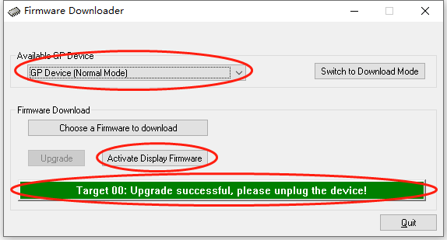
Unplug and then plug the device to PC again, the GP device will be switched to normal mode. The button to activate the display firmware will be enabled.

Slide 10
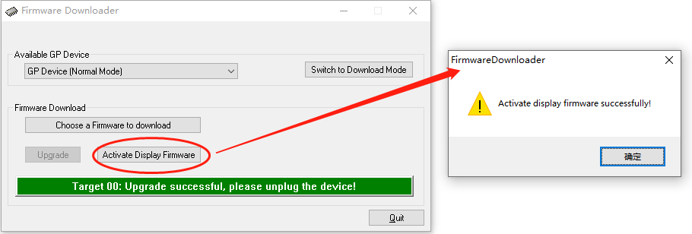
Click the button to activate the display firmware. After several seconds, a message will be prompted if successful.

